Slide 1
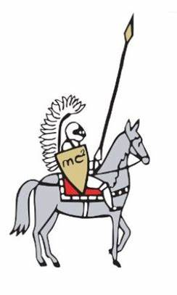

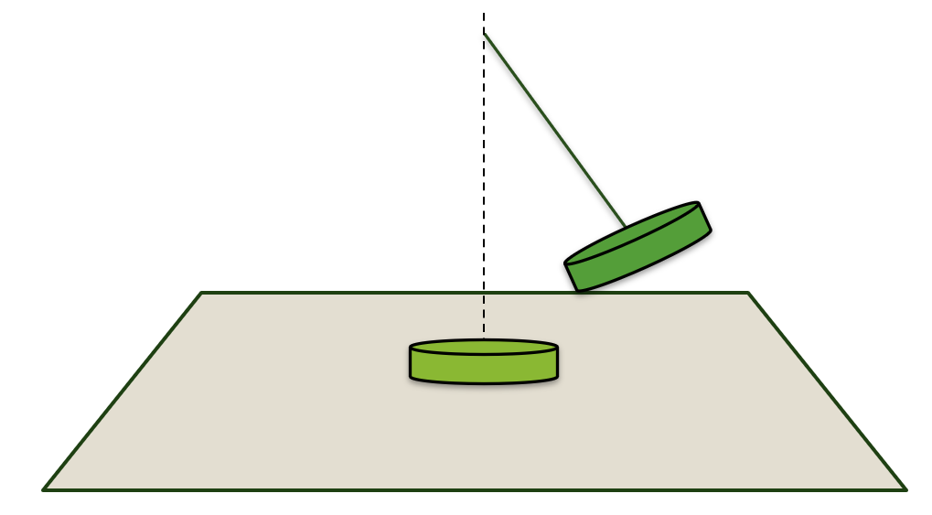
9. Magnetic Assist
Team Macao
Reporter: Feiyang Fang
Attach one or two magnets to a non-magnetic and non-conductive base such that they attract a magnet suspended from a string. Investigate how the motion of the moving magnet depends on relevant parameters.

Slide 2
Problem Statement
Attach one or two magnets to a non-magnetic and non-conductive base such that they attract a magnet suspended from a string. Investigate how the motion of the moving magnet depends on relevant parameters.
Notes:
可直接替换我的内容
这页放题目、关键词、示意图、以及变量猜想

Slide 3

Problem Statement
Attach one or two magnets to a non-magnetic and non-conductive base such that they attract a magnet suspended from a string. Investigate how the motion of the moving magnet depends on relevant parameters.
$$\text{Magnet} \text{Parameters}$$
Radius of Magnets
Magnetization of Magnets
Notes:
可直接替换我的内容
这页放题目、关键词、示意图、以及变量猜想

Slide 4

Problem Statement
Attach one or two magnets to a non-magnetic and non-conductive base such that they attract a magnet suspended from a string. Investigate how the motion of the moving magnet depends on relevant parameters.
$$\text{Position}$$
$$\text{Magnet} \text{Parameters}$$
Position of magnets
Number of magnets
Radius of Magnets
Magnetization of Magnets
Notes:
可直接替换我的内容
这页放题目、关键词、示意图、以及变量猜想

Slide 5



Problem Statement
Attach one or two magnets to a non-magnetic and non-conductive base such that they attract a magnet suspended from a string. Investigate how the motion of the moving magnet depends on relevant parameters.
$$\text{Position}$$
$$\text{Constraint}$$
Position of magnets
Number of magnets
Length of String
$$\text{Magnet} \text{Parameters}$$
Radius of Magnets
Magnetization of Magnets
Notes:
可直接替换我的内容
这页放题目、关键词、示意图、以及变量猜想

Slide 6
Problem Statement
Attach one or two magnets to a non-magnetic and non-conductive base such that they attract a magnet suspended from a string. Investigate how the motion of the moving magnet depends on relevant parameters.
$$\text{Position}$$
$$\text{Constraint}$$
Position of magnets
Number of magnets
Length of String
Height of suspension
Initial Velocity
$$\text{Magnet} \text{Parameters}$$
Radius of Magnets
Magnetization of Magnets
Notes:
可直接替换我的内容
这页放题目、关键词、示意图、以及变量猜想

Slide 7
Model
1
Experiment
2
One Magnet
3
Two Magnets
4
Conclusion
5

Slide 8
Model
A
N
Magnetic Dipole
S
Current Cylinder
B
Comparison
C

Slide 9
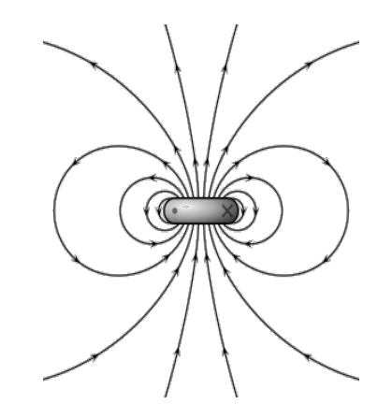

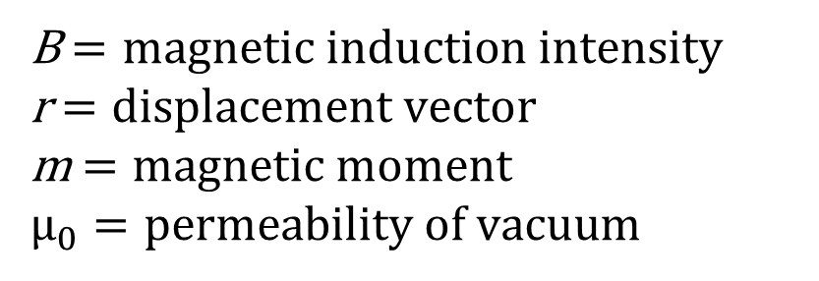
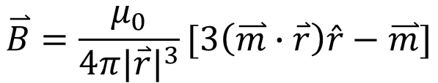
Magnetic Dipole
$$\text{Magnetic} \text{Induction} \text{Intensity}$$
$$\overset{⃑}{B}=\frac{μ_{0}}{4π{|\overset{⃑}{r}|}^{3}}[3\left(\overset{⃑}{m}∙\overset{⃑}{r}\right)\hat{r}−\overset{⃑}{m}]$$
B$=magnetic induction intensity$
r$=displacement vector$
m$=magnetic moment$
$μ_{0}=permeability of vacuu$m

Slide 10
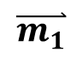
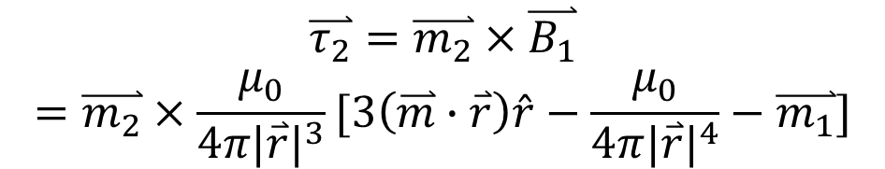
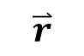

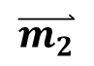
Magnetic Dipole
$$\overset{⃑}{m_{1}}$$
$$\overset{⃑}{m_{2}}$$
$$\text{Magnetic} \text{Torque}$$
$$\overset{⃑}{r}$$
$$\overset{⃑}{τ_{2}}=\overset{⃑}{m_{2}}×\overset{⃑}{B_{1}}$$
$$=\overset{⃑}{m_{2}}×\frac{μ_{0}}{4π{|\overset{⃑}{r}|}^{3}}[3\left(\overset{⃑}{m}∙\overset{⃑}{r}\right)\hat{r}−\frac{μ_{0}}{4π{|\overset{⃑}{r}|}^{4}}−\overset{⃑}{m_{1}}]$$
$$\text{Magnetic} \text{force}$$
$$\overset{⃑}{F}=\frac{μ_{0}}{4π{|\overset{⃑}{r}|}^{4}}[\left(\overset{⃑}{m_{2}}∙\overset{⃑}{r}\right)\overset{⃑}{m_{1}}+\left(\overset{⃑}{m_{1}}∙\overset{⃑}{r}\right)\overset{⃑}{m_{2}}+(\overset{⃑}{m_{1}}·\overset{⃑}{m_{2}}−5\left(\overset{⃑}{m_{1}} ∙\overset{⃑}{r}\right)\left(\overset{⃑}{m_{2}}∙\overset{⃑}{r}\right))\hat{r}]$$

Slide 11
Model
A
N
Magnetic Dipole
S
Current Cylinder
B
Comparison
C

Slide 12
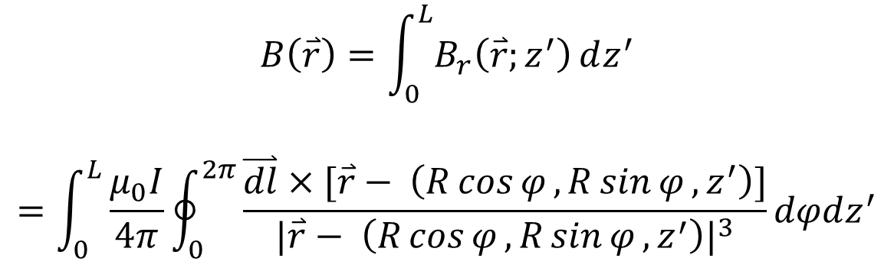
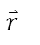
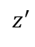
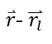
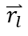
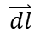
Current Cylinder
$$\text{Biot}\text{−}\text{Savart} \text{Law}$$
$$B\left(\overset{⃑}{r}\right)=\int_{0}^{L}{B_{r}\left(\overset{⃑}{r};z^{′}\right)ⅆz^{′}}$$
$$=\int_{0}^{L}{\frac{μ_{0}I}{4π}\oint_{0}^{2π}{\frac{\overset{⃑}{dl}×[\overset{⃑}{r}− \left(R\cos{φ},R\sin{φ},z^{′}\right)]}{{|\overset{⃑}{r}− \left(R\cos{φ},R\sin{φ},z^{′}\right)|}^{3}}dφdz^{′}}}$$
$\overset{⃑}{r}$- $\overset{⃑}{r_{l}}$
$$\overset{⃑}{r}$$
$$\overset{⃑}{dl}$$
$$\overset{⃑}{r_{l}}$$
$$z^{′}$$

Slide 13
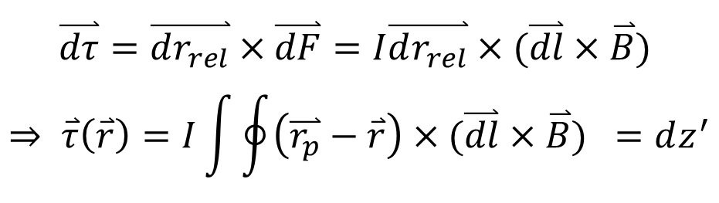
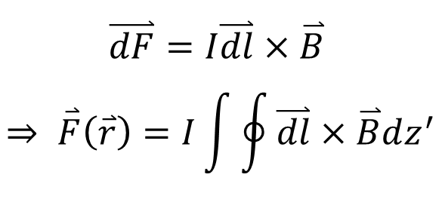
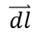
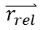
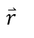
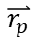
Force/Torque Analysis
$$\text{Lorentz}′\text{s} \text{Force}$$
$$\overset{⃑}{dl}$$
$$\overset{⃑}{dF}=I\overset{⃑}{dl}×\overset{⃑}{B}$$
$$⇒ \overset{⃑}{F}\left(\overset{⃑}{r}\right)=I\int{\oint{\overset{⃑}{dl}×\overset{⃑}{B}dz^{′}}}$$
$$\overset{⃑}{r_{rel}}$$
$$z^{′}$$
$$\overset{⃑}{r_{p}}$$
$$\overset{⃑}{r}$$
Torque Calculation
$$\overset{⃑}{dτ}=\overset{⃑}{dr_{rel}}×\overset{⃑}{dF}=I\overset{⃑}{dr_{rel}}×(\overset{⃑}{dl}×\overset{⃑}{B})$$
$$⇒ \overset{⃑}{τ}\left(\overset{⃑}{r}\right)=I\int{\oint{\left(\overset{⃑}{r_{p}}−\overset{⃑}{r}\right)×(\overset{⃑}{dl}×\overset{⃑}{B}) =dz^{′}}}$$
Notes:
到时候自己编程序换掉

Slide 14
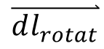
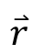
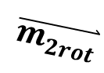
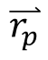
Rotational (both magnetic dipole and current cylinder)
$$\text{Rodrigues}\text{′ }\text{rotation} \text{formula}$$
$$\overset{⃑}{v_{rot}}=\overset{⃑}{v}\cos\left(θ\right)+(\hat{k}×\overset{⃑}{v})\sin\left(θ\right)+\hat{k}\left(\hat{k}∙\overset{⃑}{v}\right)(1−\cos\left(θ\right))$$
$$\overset{⃑}{m_{2rot}}$$
$$\overset{⃑}{dl_{rotat}}$$
$$\overset{⃑}{r_{p}}$$
$$\overset{⃑}{r}$$
Notes:
到时候自己编程序换掉

Slide 15
Model
A
N
Magnetic Dipole
S
Current Cylinder
B
Comparison
C

Slide 16
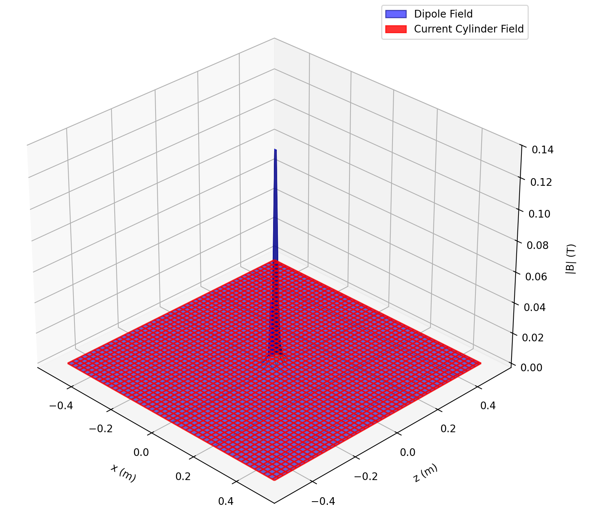
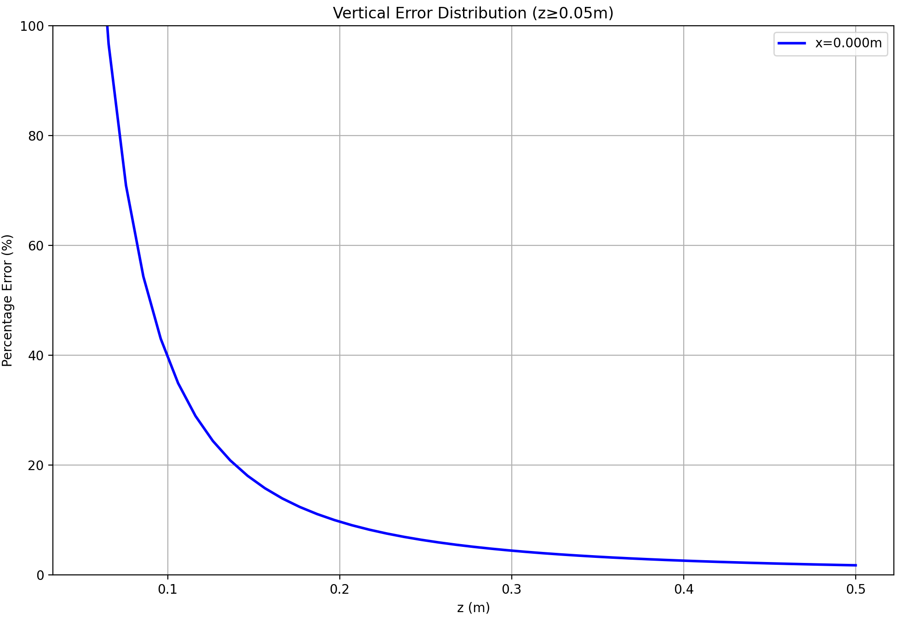

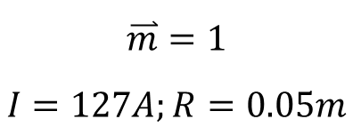
Magnetic Induction Strength Comparison
$$Parameters$$
$$\overset{⃑}{m}=1$$
$$I=127A;R=0.05m$$
Magnetic dipole fails when two magnet are close together
Magnetic dipole is a good approximation when two magnets are far away
Magnetic Induction Strength comparison
Error against height graph
Notes:
到时候自己编程序换掉

Slide 17
Model
1
Experiment
2
One Magnet
3
Two Magnets
4
Conclusion
5

Slide 18
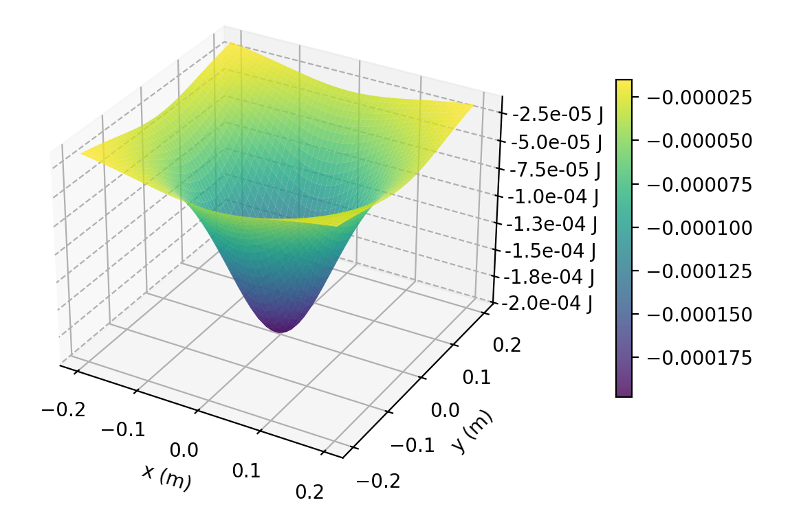
Experimental Set-up

Slide 19
Introduction
1
Preliminaries
2
Theoretical Model
3
Key Parameters
4
Conclusion
5

Slide 20
One Magnet
A
Lagrangian
Parameters
B

Slide 21
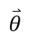
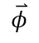
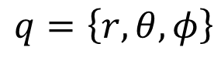
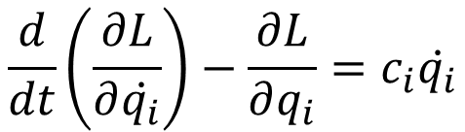
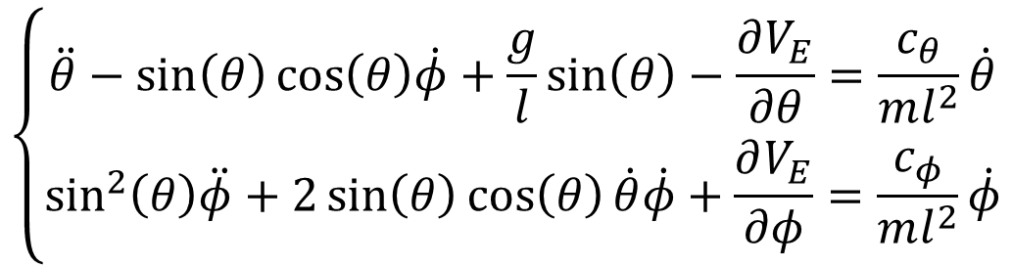
Lagrangian
$L=\frac{1}{2}ml^{2}\left({\dot{θ}}^{2}+{\sin{θ}}^{2}{\dot{φ}}^{2}\right)−V_{E}−$ $mg\left(h+l(1−\cos{θ})\right)$
$$\overset{⃑}{φ}$$
$$\frac{d}{dt}\left(\frac{∂L}{∂\dot{q_{i}}}\right)−\frac{∂L}{∂q_{i}}=c_{i}\dot{q_{i}}$$
$$\overset{⃑}{θ}$$
$$l$$
$$\left\{\begin{aligned}\ddot{θ}−\sin\left(θ\right)\cos\left(θ\right)\dot{φ}+\frac{g}{l}\sin\left(θ\right)−\frac{∂V_{E}}{∂θ}=\frac{c_{θ}}{ml^{2}}\dot{θ} \\ \sin^{2}\left(θ\right)\ddot{φ}+2\sin\left(θ\right)\cos\left(θ\right)\dot{θ}\dot{φ}+\frac{∂V_{E}}{∂φ}=\frac{c_{φ}}{ml^{2}}\dot{φ}\end{aligned}\right.$$
$$q=\left\{r,θ,φ\right\}$$

Slide 22
Force Distribution
Fit with Experimental
Notes:
到时候自己编程序换掉

Slide 23
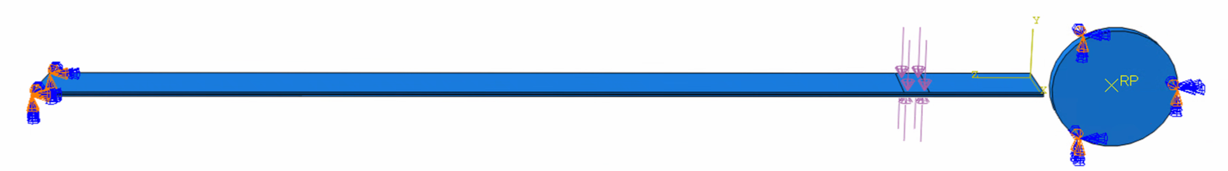
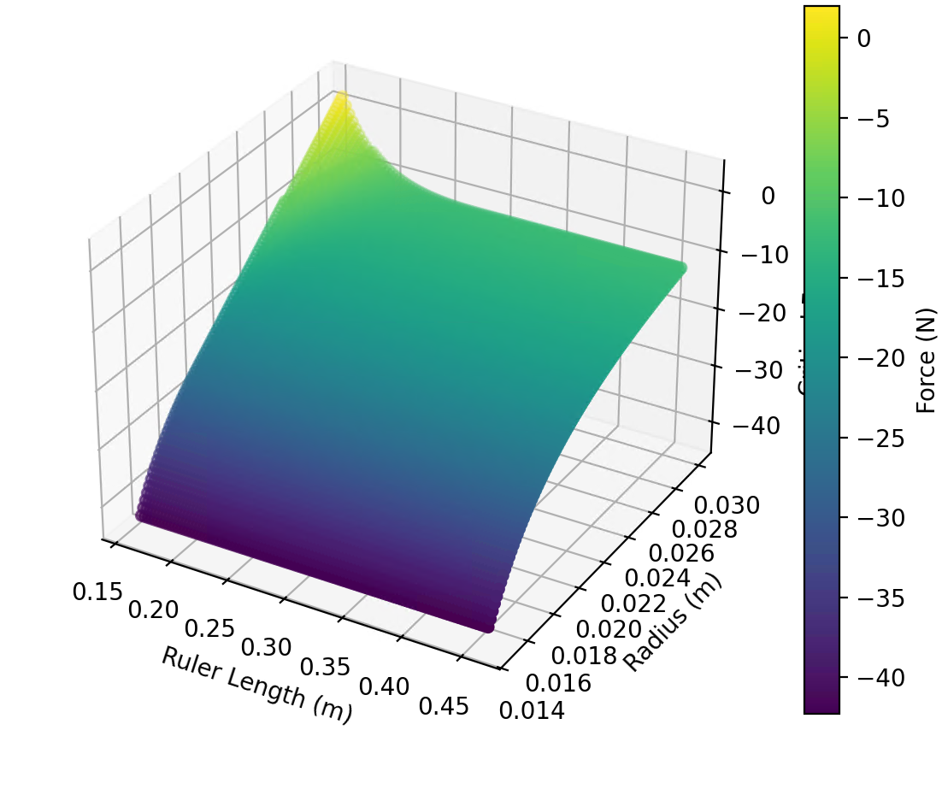
Theoretical Model
A
Magnet Model
One Magnet
B
Two Magnets
C

Slide 24
Theoretical Result

